Slide 1
Total Cost of Ownership model – --Innovation-- systems
Michiel Tognini

Slide 2
Inhoud
1. Definitie Total Cost of Ownership
2. Voorgaand onderzoek TCO componenten
3. Methodologie
4. Assumpties berekeningen
5. Uitleg model
6. Discussie en conclusie

Slide 3
1. Definitie Total Cost of Ownership
Strategische tool lifecycle management
Meerdere doeleinden:
  Vendor selection
  Asset configuration
  Contract definitions suppliers
  Operational decisions
Ex-ante & Ex-post methode
Cost performance systeem

Slide 4
2. Voorgaand onderzoek TCO componenten
Thijs Herwig (2018)
Peter Swaving Dijkstra (2020)

Slide 5


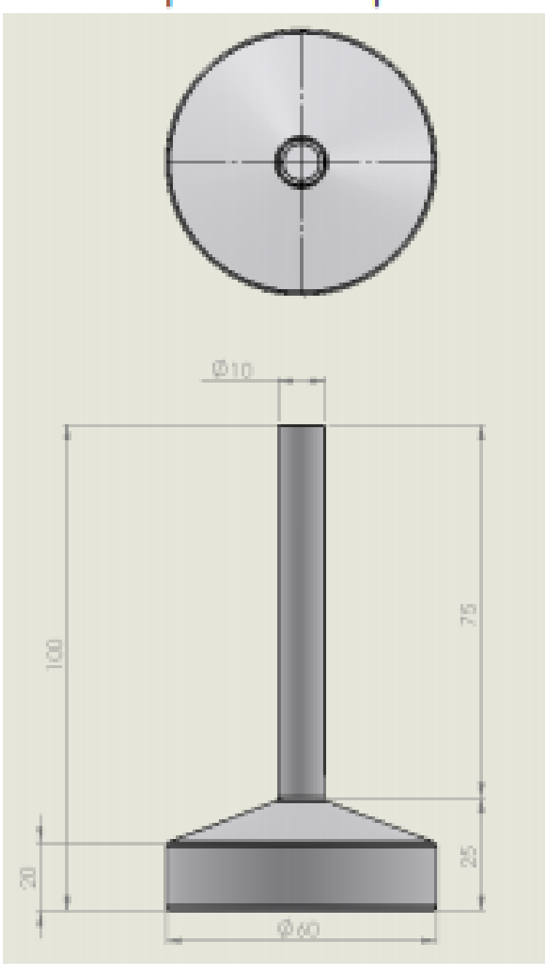
2.1 Flexible bladder
Herwig
  Oud concept
  Beton
Dijkstra
  Reservoir inputs 🡪 Volumetric capacity
  Assumpties:
    12,000 kubieke meter
    70x20x10

Slide 6
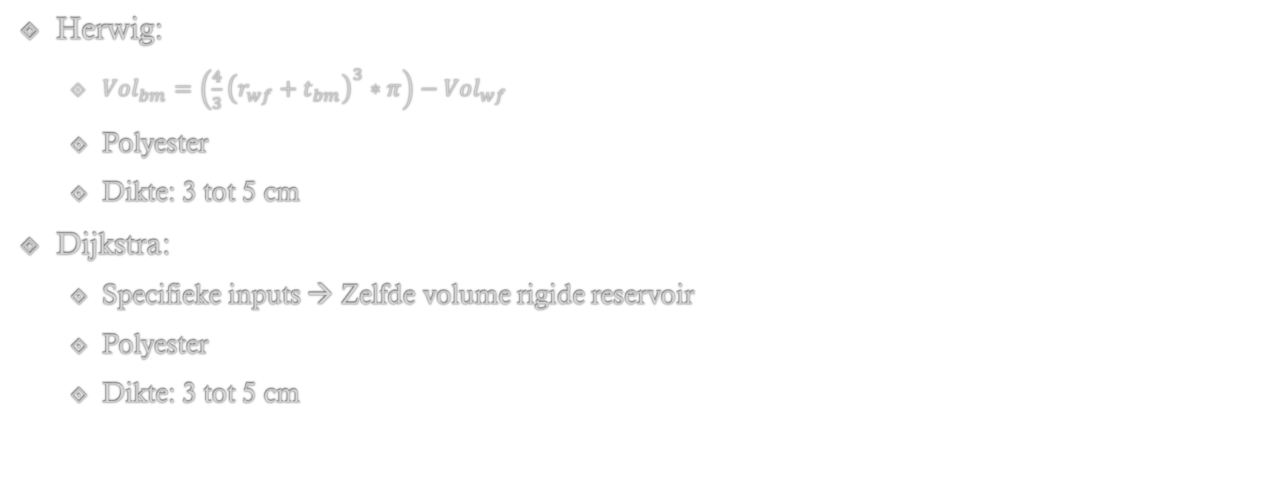
2.2 Flexible bladder

Slide 7
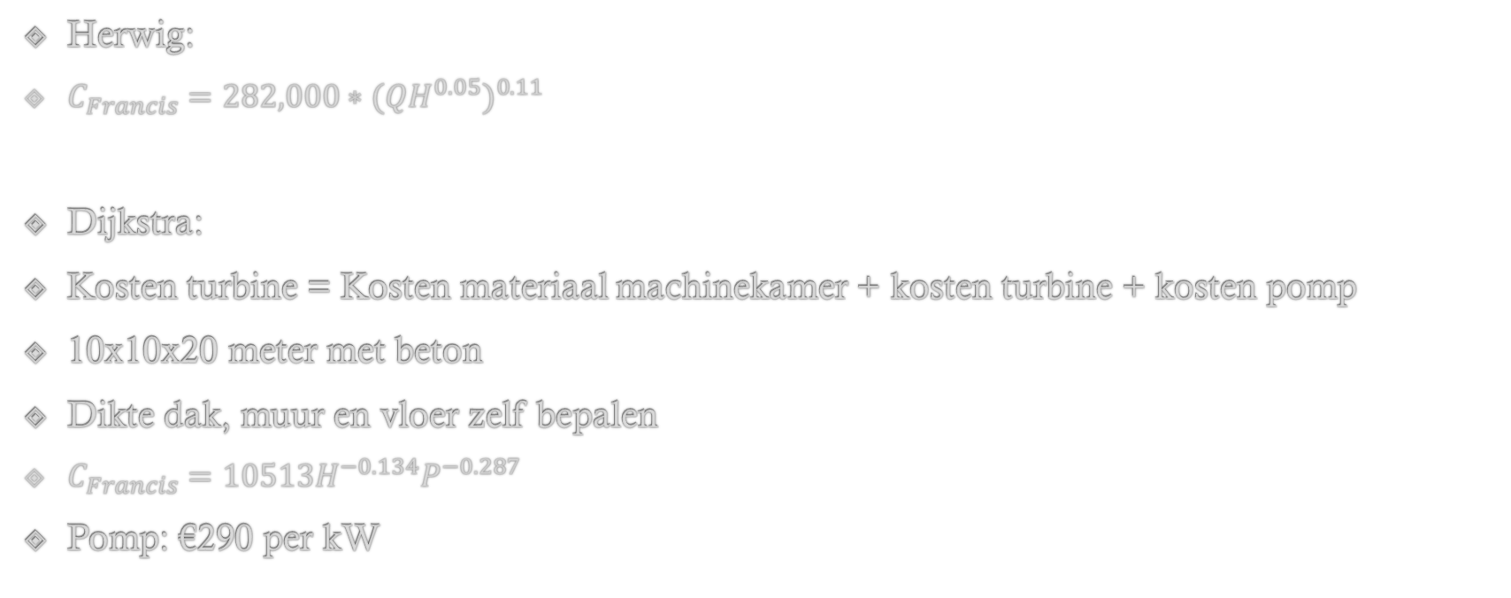
2.3 Turbine systeem

Slide 8
2.4 Grid connectie
Herwig
  12% van de Procurement cost
Dijkstra
  €270,000 per MW power capacity
  16% van total investment cost
Research Emilija Lazdanaitė

Slide 9
2.5 Assembly
Internship Di Donna
  Dagen per assemblie operatie
  Kosten per dag
Dijkstra
  Zelfde methode, kleine aanpassing

Slide 10
2.6 Installatie
Dijkstra:
  Dredging days
  Depositioning days
  1 gecombineerde dag vessel rent voor towing en cable placement

Slide 11
2.7 Operation & Maintenance
Herwig: Gecombineerde methode
  Methode De Vlugt
    €130-290 kW/jaar
  Oude methode Marijn
    Percentage Procurement
Dijkstra:
  Methode De Vlugt
    Gemiddelde lower en upper bound
  £76,000 MW/jaar

Slide 12
2.8 Decommissioning & Disposal
Herwig:
  Geëxtrapoleerde informatie Shell
Dijkstra:
  14% Procurement
  £330,000 per MW

Slide 13
3. Methodologie
Stap 1: informatie opdoen
  Literatuur en kennis studie
  Modellen en documenten bedrijf
  Interview Boskalis
  Opinie Frits, Max, Jefta, Marijn
  Voorgaande onderzoeken --Company--
Stap 2: Modelleren
Stap 3: Interpreteren
Stap 4: Rapporteren

Slide 14
4. Assumpties berekeningen
Parameter | --Version 1-- Design waarde | --Version 2-- Design waarde
Water depth [m] | 38 | 97.5
Dredging depth [m] | 100 | 0
Effective depth [m] | 92.5 | 92.5
Density seawater [kg/m3] | 1,025 | 1,025
Distance wind farm [km] | 20 | 20
Distance between –Innovations– [km] | 3.44 | 3.44
Life cycle [Years] | 20 | 20
Battery volume [MWh] | 6 | 6
Battery power [MW] | 4 | 4
Turbine efficiency | 88.5% | 88.5%
Pump efficiency | 87.5% | 87.5%

Slide 15
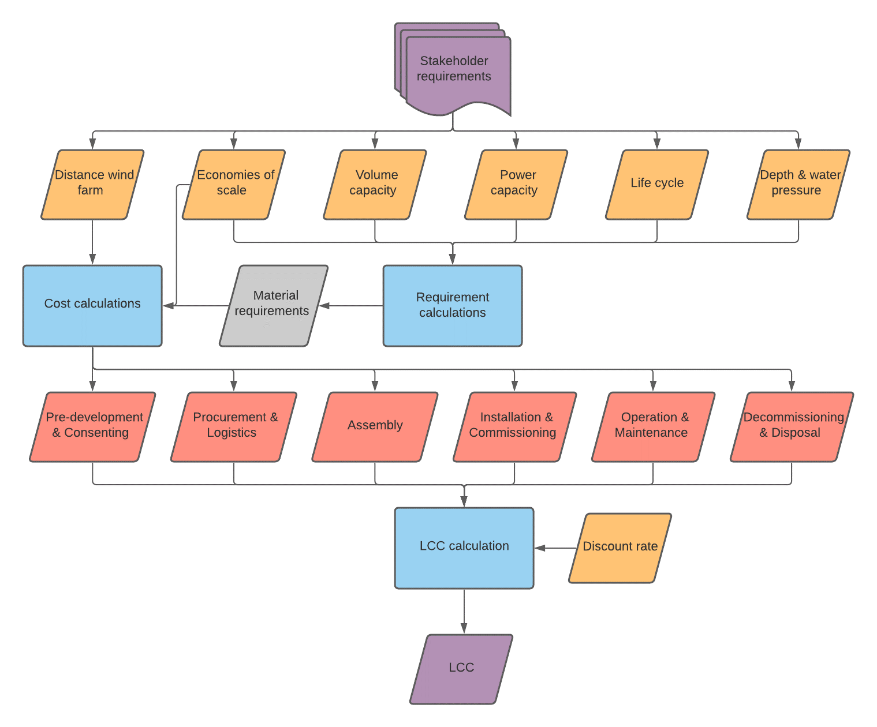
5. Uitleg model

Slide 16
5.1 Basic inputs
Locational parameters
System parameters
Economic parameters
Material parameters

Slide 17
5.2 Requirement calculations
Rigid reservoir | Flexible reservoir | Other | Legend:
Main reservoir | Main bladder | Ballast stones | Green = --Version 1--
Metal base | Synthetic strip | Manifold | Blue = --Version 2--
Supporting ribs | Stainless strip | Geotextile | Purple = --Version 1--+--Version 2--
Compartment wall | Bolts & Inserts | Pump & Pipe
Tension cables |  | Umbilical system
Shaft

Slide 18
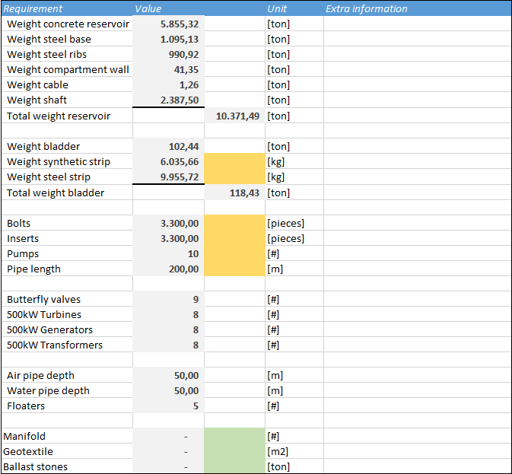
5.3 Total of requirements
Total weight reservoir
  Economies of Scale maximum
  Assembly cost
Total weight bladder
  Assembly cost

Slide 19
5.3 Pre-development & Consenting cost
Project management 🡪 3% of Procurment
Legal authorization: 🡪 0.13% of Procurement
Surveys 🡪 0.8% (3MW/500MW) of Survey cost 500MW wind farm
Engineering 🡪 0.8% of Engineering cost 500MW wind farm
Contingencies 🡪 10% of Procurement
  Verspreid over aantal ingevulde cycle years

Slide 20
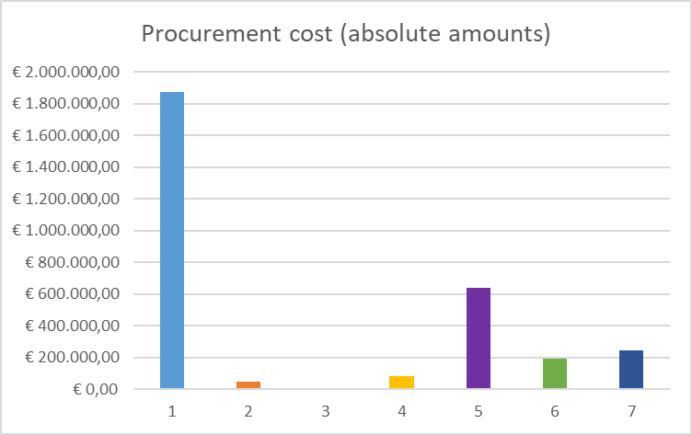
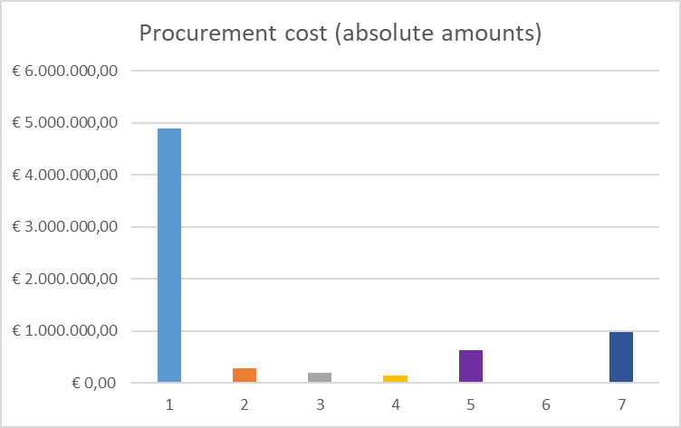
5.4 Procurement cost (absolute amounts)
--Version 1-- design
--Version 2-- design
1=Total cost rigid reservoir; 2=Total cost flexible bladder; 3=Total cost pumping system; 4=Total cost umbilical system; 5=Total cost turbine system; 6=Total cost --Version 1-- design extra’s; 7=Total other costs

Slide 21
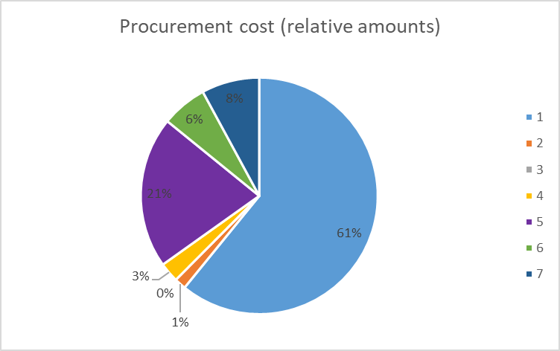
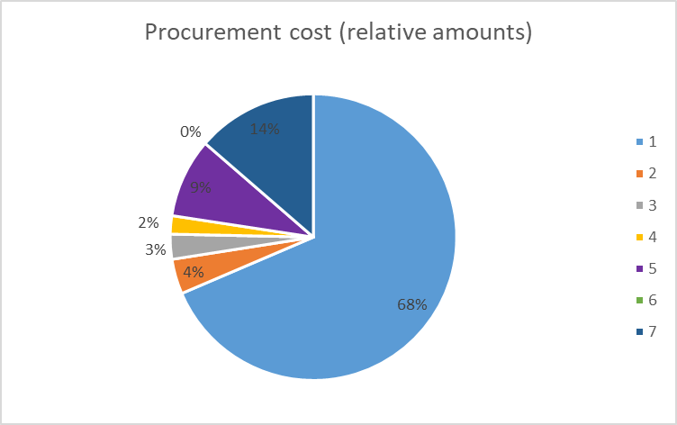
Procurement cost (relative amounts)
--Version 1-- design
--Version 2-- design
1=Total cost rigid reservoir; 2=Total cost flexible bladder; 3=Total cost pumping system; 4=Total cost umbilical system; 5=Total cost turbine system; 6=Total cost --Version 1-- design extra’s; 7=Total other costs

Slide 22
5.5 Assembly cost
Assembly dagen calculatie
  Steel frame positioning
  Steel frame welding (--Version 2-- variant)
  Rigid reservoir positioning
  Rigid reservoir assembly
  Rigid reservoir miscellaneous
  Engine room assembly
  Flexible bladder assembly
Gerelateerde kosten
  Dock cost €170,564
  Lighting cost €14,014
  Forklift cost €7,917
  Cranes cost €48,117
  Salary cost €1,557
  TOTAL ASSEMBLY COST €242,170

Slide 23
5.6 Installation & commissioning
Installation
  Stap 1: Baggeren en zeebed preparatie
  Stap 2: Rigide reservoir / --Innovation-- systeem installeren
  Stap 3: Gat dichtmaken
  Stap 4: Flexibele blaas installeren
  Stap 5: Stortstenen plaatsen
Commissioning
  Side acceptance test (2 dagen, 4 werknemers)
  Optioneel
    Jaarlijkse performance monitoring and Warranty kosten
    Jaarlijkse P&I verzereringskosten
    Jaarlijkse Hull and Machinery verzekeringskosten

Slide 24
5.6.1 Baggeren

Slide 25
5.6.3 Gat dichtmaken

Slide 26
5.6.4 Flexibele blaas installeren

Slide 27
5.6.5 Stortstenen plaatsen

Slide 28
5.6.6 Installation samengevat (--Version 1--)

Slide 29
5.6.6 Installation samengevat (--Version 2--)

Slide 30
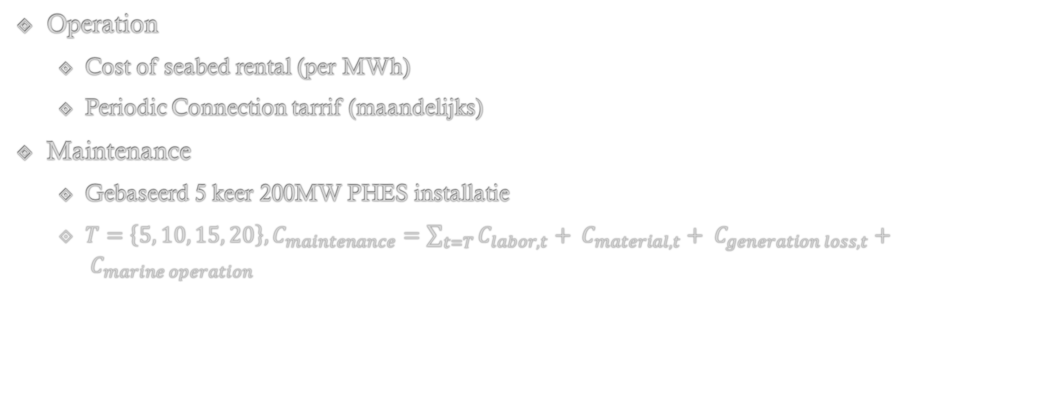
5.7 Operation & Maintenance

Slide 31
5.7.1 Maintenance componenten
Generator
Warning transformer
Current transformer
Voltage transformer
Main power transformer
Internal transformer
Butterfly valve
Turbine maintenance

Slide 32
5.7 Decommissioning & Disposal
Decommissioning cost
  Enkele dive support vessel
  2 uur verwijdering per system
Disposal opbrengsten
  5 meter Schacht 🡪 Salvage waarde scrap steel
  Whitehead (2013): Gewicht staal 2MW Francis turbine 🡪 Salvage waarde stainless steel
  Habib and Wenzel (2016): kg/MW koper in permanent magnet generator 🡪 Salvage waarde koper
  Chen, Yang and Zhao (2011): material intensity 1.25MW transformator wind turbine 🡪 Salvage waarde scrap steel en koper

Slide 33
5.8 TCO overzicht (--Version 1-- design)
Pre-development & Consenting: € 637,346
Procurement: € 3,077,216
Assembly: € 121,183
Installation & Commissioning: € 1,110,633
Operation & Maintenance: € 248,800
Decommissioning & Disposal: -€ 35,512
Total Cost of Ownership: € 5,159,665
TCO ($/kWh): $1,036
TCO ($/kW): $1,554

Slide 34
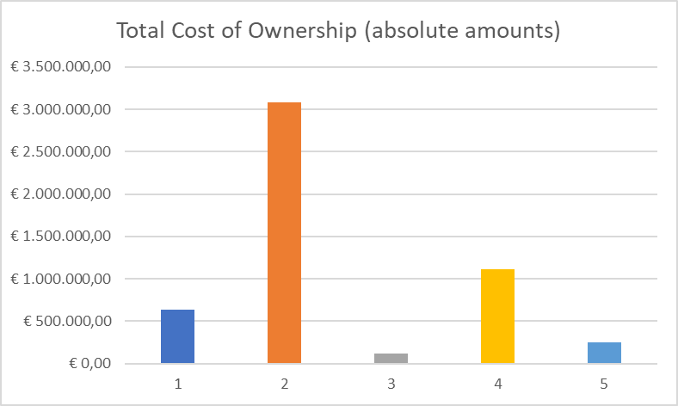
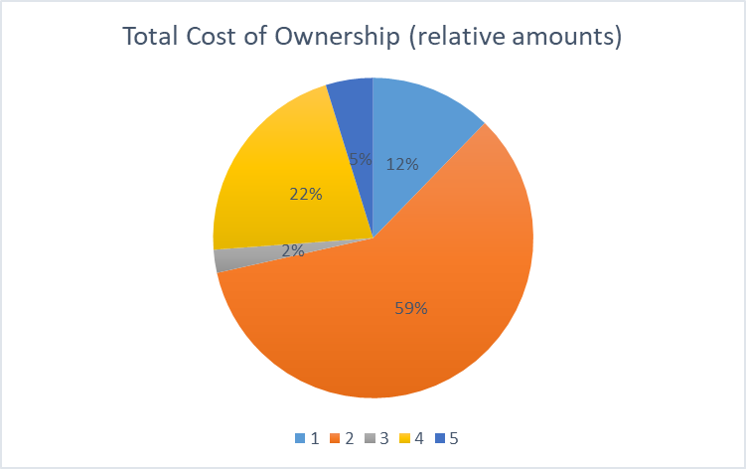
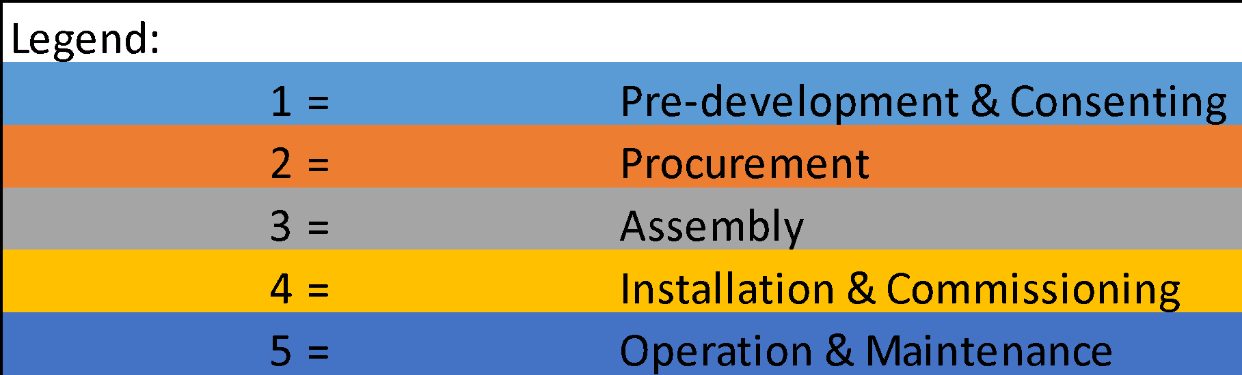

Slide 35
TCO overzicht (--Version 2-- design)
Pre-development & Consenting: € 965,597
Procurement: €7,127,165
Assembly: € 242,170
Installation & Commissioning: € 79,800
Operation & Maintenance: € 248,800
Decommissioning & Disposal: -€ 35,512
Total Cost of Ownership: €8,628,019
TCO ($/kWh): $1,733
TCO ($/kW): $2,599

Slide 36
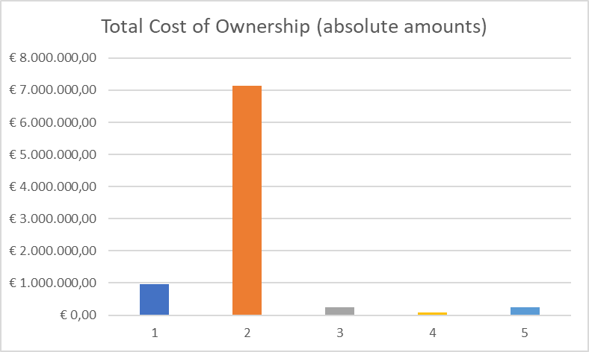
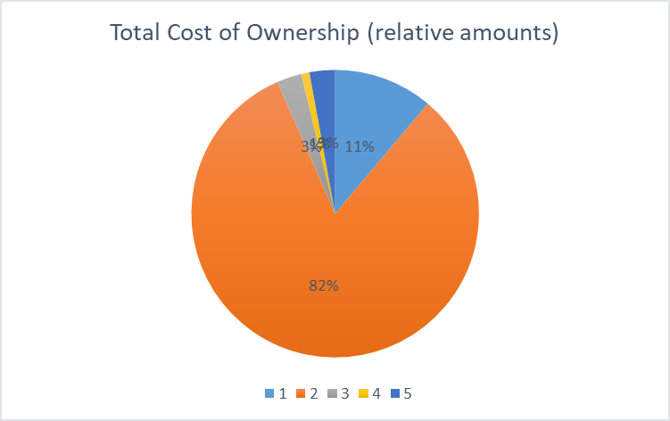

Slide 37
Discussie & Conslusie
Kritieke parameters:
  Volume capacity
  Power capacity
  Economies of Scale
Kritieke kostencategorie 🡪 Procurement
  --Version 1--: 59% totaal
  --Version 2--: 59% totaal
Kritieke kostencategorie 🡪 Installatie
  --Version 1--: 22% totaal

Slide 38
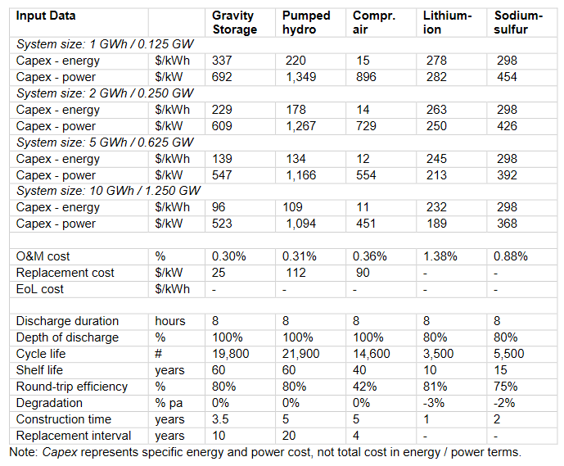
--Version 1-- design
  TCO ($/kWh): $1,036
  TCO ($/kW): $1,554
  CAPEX ($/kWh): $618
  CAPEX ($/kW): $927
  OPEX (%): 5%
--Version 2-- design
  TCO ($/kWh): $1,733
  TCO ($/kW): $2,599
  CAPEX ($/kWh): $1,431
  CAPEX ($/kW): $2,147
  OPEX (%): 3%
Toekomstig onderzoek --Company--
  Simulatie Maintenance
  Toepassen onderzoek Emilija Lazdanaitė
  Inventory management

Slide 39
EINDE

